Slide 1

Sponsorship Programme for Public Health Service Employees wishing to train as Nurses/Midwives (HSE HR Circular 40/2020: Sponsorship for Public Health Service Employees wishing to train as Nurses/Midwives)
Judy Ryan Director Nursing and Midwifery Planning and Development South East (NMPDU) NMPDU South East National lead for Sponsorship Programme.

Slide 2

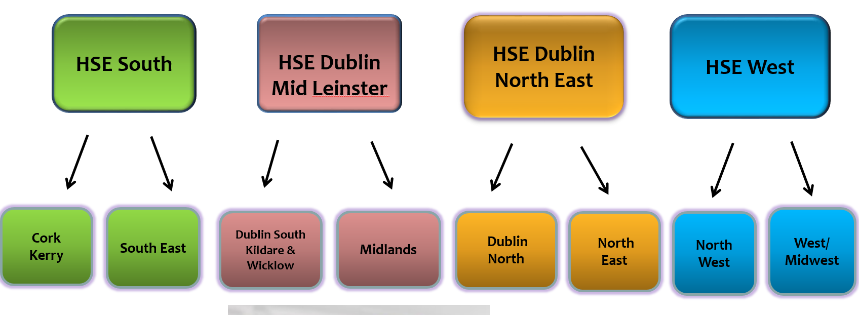
Office of the Nursing and Midwifery Services Director (ONMSD) and NMPDUs

Slide 3


HSE HR Circular 40/2020: Sponsorship for Public Health Service Employees wishing to train as Nurses/Midwives
Notes:
2002, by the Minister for Health and Children namely the sponsorship scheme for eligible, suitable and experienced public health service employees wishing to train as nurses

Slide 4

Nursing and Midwifery
Nursing an Midwifery Board of Ireland (NMBI) Regulators
Divisions of the NMBI register for Undergraduate Nursing Programmes
General Nurses Division
Children's Nursing Division
Intellectual Disability Nursing
Psychiatric Nurses Division
Midwifery

Slide 5
The Sponsorship Scheme
Employing organisation
Statutory (HSE) or voluntary (Section 38) agency in the Irish public health service in which the employee is working when they commence the sponsorship.
Applicants can be working in:
An acute/non-acute hospital
A community care area
Intellectual disability services
A long-term care facility
A mental health service

Slide 6
Eligibility Criteria for Sponsorship Programme
Employees in the Irish Public Health Services currently encompassed under the support services grades such as Health Care Assistants/Multi Task Attendants who are involved in the direct delivery of care to patients/clients within a nursing/midwifery context.
Have at least two consecutive years relevant1 service as an employee in the Irish public health service within the last five years on the 1st day of January of the year in which they apply for sponsorship.

Slide 7
Eligibility Criteria for Sponsorship Programme
Be employed as a permanent employee on a full-time or part-time basis. (where employed on a part-time basis, must have been working an average of not less than 15 hours per week)
Have a satisfactory service record and fulfill the relevant service requirement as verified by the employer on the sponsorship application
Must qualify as a Mature Code Applicant on 1st January in the year in which they apply for a place on the pre-registration Nursing/Midwifery Degree Programme
Must have applied for a nursing/midwifery degree programme through the CAO in the area of care in which her/his employing agency is involved in delivering i.e. General Nursing or General and Children's Nursing etc.
Undertake and successfully pass the written assessment test administered by Public Appointments Service (PAS) on behalf of the Nursing & Midwifery Board of Ireland (NMBI)

Slide 8


Steps in the application process
Step 1: Make a formal application through the Central Applications Office (CAO) as a Mature Code Applicant https://www.cao.ie/
Step 2: Using a valid CAO number, register for the assessment tests
Step 3: Apply for sponsorship to the through the Office of the National Lead for the Sponsorship Scheme (NMPDU SE)
Notes:
Step 2: Using a valid CAO number, register for the assessment tests
Step 3: Complete the suite of tests within the timeframe (applicants must be successful in assessment test to be considered for an offer as a mature applicant (offer of a place not guaranteed).
The assessment test is year specific and the results may not be carried forward (for sponsorship scheme)

Slide 9
Steps in the application process
Step 4: Submit a completed sponsorship application form to the HSE National Lead (NMPDU SE) by the designated closing date. https://healthservice.hse.ie/aboutus/onmsd/cpd-for-nurses-and-midwives/onmsd-sponsorship-schemes/publichealth-service-employees.html
Step 5: Submit the PAS written assessment test score to the HSE National Lead (NMPDU SE) for this scheme once available.
Step 6: Results for Mature code applicants are notified by the PAS of the result of their written assessment in early June.
*Only those who satisfy the eligibility criteria are considered for sponsorship.

Slide 10
Assessment test
The assessment test is year specific and results may not be carried forward (for sponsorship scheme)
The assessment test comprises three separate tests:
Verbal reasoning (also called ‘Understanding of basic instructions’
Numerical reasoning
Job simulation
Notes:
verbal reasoning (also called ‘Understanding of basic instructions’):
this test measures your ability to understand information and how you evaluate that information. . numerical reasoning: this test measures your ability to interpret, understand and use numerical information. . job simulation: this test attempts to identify your likely response when presented with scenarios typical of what could occur in a job situation. It measures a range of skills and qualities required of a student nurse/midwife, ranging from taking care of someone through to taking responsibility in a situation.

Slide 11
The Awarding of places on the Sponsorship Programme
30 places per year (dependant on funding allocation)
Order of merit list for eligible applicants for each region developed based on PAS assessment test.
First applicants considered are those who receive a first round offer from the CAO Round A in the year of application.
Highest order of merit of PAS assessment test
Received an offer of a place by CAO on pre registration nursing/midwifery degree programme in the area of nursing/midwifery in which her/his employing agency is delivering

Slide 12
Conditions of Sponsorship
Service commitment
Immediate registration with NMBI
Commit to work as a nurse/midwife for that employer for 5 years
Failure to undertake the commitment would result in the repayment of fees
*Part-time employees need to work full time for the duration of the programme but can revert back to part-time (with the employees agreement)

Slide 13
Conditions of Sponsorship
Required to work all periods outside academic semester (except on A/L or during supernumerary placement
A/L – retain leave entitlement
Funding – Fees paid as part of the Sponsorship (no fees for repeat modules)
Retention of salary – retain existing substantive basic salary

Slide 14

Closing Slide
Further information is available from: Nursing and Midwifery Planning and Development Unit South East Kilcreene Hospital Complex Kilkenny Telephone: (056) 778 5620 Email: nmpdu.kilkenny@hse.ie
Please read CAO Handbook 2023

